Slide 1


MAJOR PROJECT
Anomaly Detection in Cyber Security
Team Members
B Jagadish Chandra 20BCS032
Mokalla Bhanu Prasad 20BDS033
Taneti Ravi Chand 20BDS057
Vineeth S R 20BCS137
Under the Guidance of
Dr. Rajendra Hegadi

Slide 2
AGENDA
Introduction
Anomaly Detection
About the data
Data Preprocessing
Algorithms used
Code and results
Future work

Slide 3

INTRODUCTION
Imagine a bustling city with millions of financial transactions occurring every minute, a complex network transmitting critical data, or a vast manufacturing facility operating around the clock. In these dynamic environments, subtle irregularities often escape the naked eye but can have profound implications.

Slide 4

ANOMALY DETECTION
Anomaly Detection:
anomaly detection is generally understood to be the identification of rare items, events, or observations that deviate significantly from the majority of the data and do not conform to a well-defined notion of normal behavior.
Benefits of anomaly detection in cyberspace:
1) Early Threat Identification.
2) Fraud Prevention
3) Insider Threat Detection
4) Network Security Enhancement
5) Improving Incident Response

Slide 5
DATA
datasets: training, validation, and testing.
Features:
blue colored: used in models; red colored: label; grey colored: excluded;
Evil
Process Id
Parent Process Id
User Id
Mount namespace
Event Id
Args num
Time stamp
Return value
Args
Thread Id
Stack Address
Host name
Process Name
Event name

Slide 6
train data
timestamp | processId | threadId | parentProcessId | userId | mountNamespace | processName | hostName | eventId | eventName | stackAddresses | argsNum | returnValue | args | sus | evil
129.0506 | 382 | 382 | 1 | 101 | 4.03E+09 | systemd-resolve | ip-10-100-1-217 | 41 | socket | [140159195621643, 140159192455417, 94656731598592] | 3 | 15 | [{'name': 'domain', 'type': 'int', 'value': 'AF_UNIX'}, {'name': 'type', 'type': 'int', 'value': 'SOCK_DGRAM|SOCK_CLOEXEC'}, {'name': 'protocol', 'type': 'int', 'value': 0}] | 0 | 0
129.0512 | 379 | 379 | 1 | 100 | 4.03E+09 | systemd-network | ip-10-100-1-217 | 41 | socket | [139853228042507, 93935071185801, 93935080775184] | 3 | 15 | [{'name': 'domain', 'type': 'int', 'value': 'AF_UNIX'}, {'name': 'type', 'type': 'int', 'value': 'SOCK_DGRAM|SOCK_CLOEXEC'}, {'name': 'protocol', 'type': 'int', 'value': 0}] | 0 | 0

Slide 7
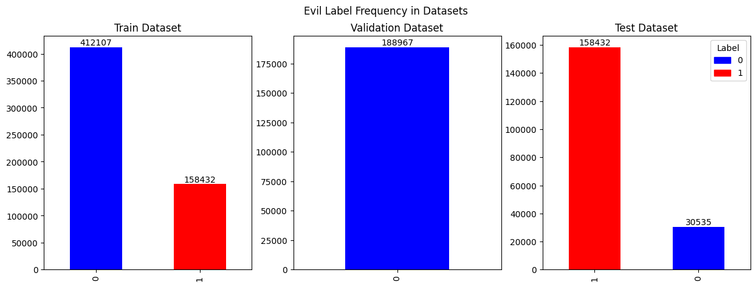

Slide 8
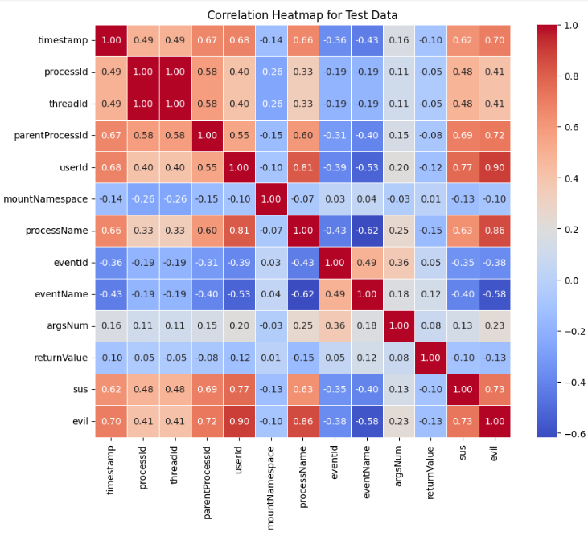

Slide 9


DATA PREPROCESSING
Feature
Mapped to
process name
label encoded
event name
Process Id
0&1
Parent PID
0&1
User Id
0&1
Mount
namespace
0&1
Event Id
No mapping
Args num
No mapping
Return Value
0&1

Slide 10
label encoding
Process Name
Event name
consistent labels across different runs and models
Mapping for processName:
Numerical label 0 corresponds to '(activate)'
Numerical label 1 corresponds to '(direxec)'
Numerical label 2 corresponds to '(sd-executor)'
Mapping for eventName:
Numerical label 0 corresponds to 'accept'
Numerical label 1 corresponds to 'accept4'
Numerical label 2 corresponds to 'access'

Slide 11








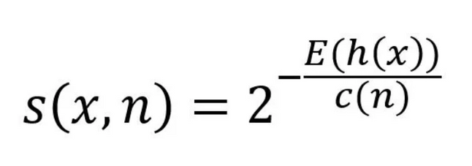
MODEL:
ISOLATION FOREST
Technique for identifying outliers in data
Isolation Forest
scores
1
0.5
0
0
if E[h(x)] << c(n) then S(x,n) =1
if E[h(x)] >> c(n) then S(x,n) = 0
if E[h(x)] = c(n) then S(x,n) = 0.5
where S(x,n) is score
E[h(x)] is the average path length for islolating data point x and c(n) in atree the average depth of data points in a tree

Slide 12
MODEL:
RANDOM FOREST
Random Forest is an ensemble learning technique widely used for anomaly detection in cybersecurity.
Random Forest is a popular ensemble learning algorithm that combines multiple decision trees.
Each decision tree is trained on a random subset of features and data samples.
The final prediction is made by aggregating the predictions of individual trees through voting or averaging.

Slide 13
Why RFC Allgorithm ?
1) High Accuracy
2) Handling Imbalanced Data
3) Interpretability
4) Scalability

Slide 14
4 steps used in this model to check anomaly detection
1) Ensemble Learning Technique
2) Training Process
3) Feature Importance
4) Prediction and Evaluation

Slide 15
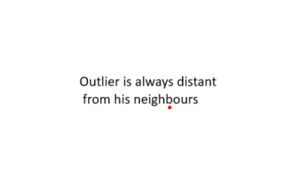




MODEL:
LOCAL OUTLIER FACTOR
Reachability distance

Slide 16



Choosing the correct KNN value is very important
Here k=2 predict outliers as inliers

Slide 17

n_neighbors = 4
the radius of the circle will be the radius needed by the circle to cover 4 neighbors
area of the circle is selected observation’s density

Slide 18
KNN of selected neighbors

Slide 19


vs

Slide 20
CODE AND RESULTS
https://colab.research.google.com/drive/10XZUgQoo0CgLNYxak-y9PO30y4ZG_VVZ?usp=sharing

Slide 21

FUTURE WORK
Monitoring system that alerts the users regarding malicious activity in the system

Slide 22
References
Kate Highnam, Kai Arulkumaran, and N.Jennings. BETH Dataset: Real Cybersecurity Data for Anomaly Detection Research. Computer Science, Engineering, 2021.
Marina Evangelou, and Niall M. Adams. An anomaly detection framework for cyber-security data. Computers and Security, 2020.
https://youtu.be/9-PHBzI_rDk?si=s2i-Z_AKR2nI2sMn
http://www.gatsby.ucl.ac.uk/~balaji/udl2021/accepted-papers/UDL2021-paper-033.pdf

Slide 23
﻿THANK YOU

